Slide 1
Chapter 11: Storage and File Structure

Slide 2
Chapter 11: Storage and File Structure
Brief overview of Physical Storage Media for Databases
To know its incidence on the design and usage of DBMSs
Magnetic Disks
RAID
Storage Access and buffer management
File Organization
Representation of records
Organization of Records in Files
Data-Dictionary Storage
Storage and File Organization in Oracle 10g

Slide 3
Classification of Physical Storage Media
In the end, a database must be physically stored in computer(s)
Several aspect of storage media must be taken into account
Speed with which data can be accessed
Cost per unit of data
Reliability
data loss on power failure or system crash
physical failure of the storage device
Can differentiate storage into:
volatile storage: loses contents when power is switched off
non-volatile storage:
Contents persist even when power is switched off.
Includes secondary and tertiary storage, as well as batter- backed up main-memory.

Slide 4
Physical Storage Media for DBMSs
Main memory:
fast access (10s to 100s of nanoseconds; 1 nanosecond = 10^{–9} seconds)
generally too small (or too expensive) to store the entire database
Volatile — contents of main memory are usually lost if a power failure or system crash occurs.
Magnetic-disk
Primary medium for the long-term non-volatile online storage of data; typically stores entire database.
Data must be moved from disk to main memory for access, and written back for storage
Much slower access than main memory
direct-access – possible to read data on disk in any order
Reliable: usual mean time to failure is now of about 3 to 5 years
Optical and tape storage
Mainly backups (offline storage)

Slide 5
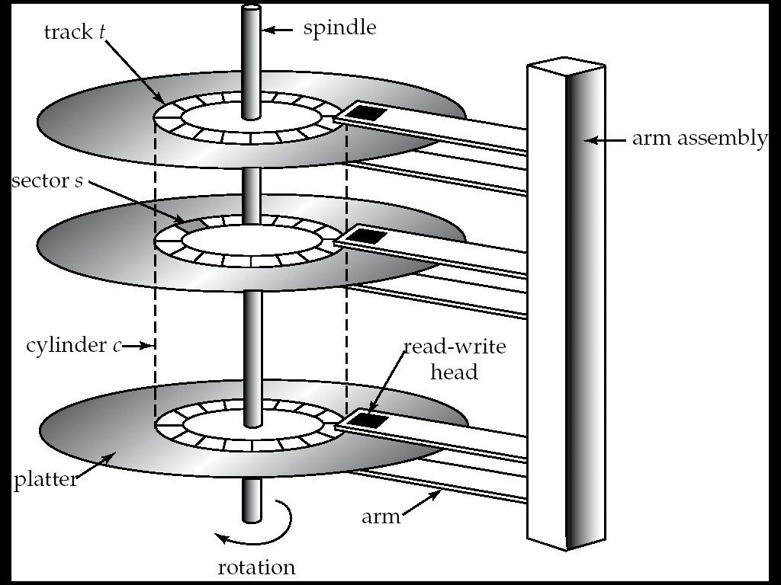
Magnetic Hard Disk Mechanism
It is worth taking a look at how magnetic disks work.
After all they are the place where the databases are stored!

Slide 6
Magnetic Disks
Read-write head
Positioned very close to the platter surface (almost touching it)
Reads or writes magnetically encoded information.
Surface of platter divided into circular tracks
Over 50K-100K tracks per platter on typical hard disks
Each track is divided into sectors.
A sector is the smallest unit of data that can be read or written.
Sector size typically 512 bytes
Typical sectors per track: 500 (on inner tracks) to 1000 (on outer tracks)
To read/write a sector
disk arm swings to position head on right track
platter spins continually; data is read/written as sector passes under head
Head-disk assemblies
multiple disk platters on a single spindle (1 to 5 usually)
one head per platter, mounted on a common arm.
Cylinder i consists of i^{th} track of all the platters

Slide 7
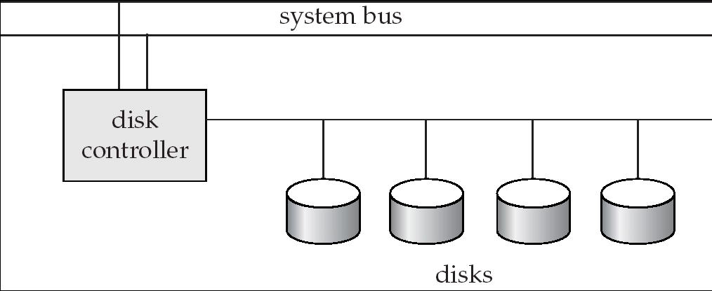
Disk Subsystem
Multiple disks connected to a computer system through a controller
Controllers functionality (checksum, bad sector remapping) often carried out by individual disks; reduces load on controller
Disk interface standards families
ATA (AT adaptor) range of standards
SATA (Serial ATA)
SCSI (Small Computer System Interconnect) range of standards
Several variants of each standard (different speeds and capabilities)

Slide 8
Performance Measures of Disks
Access time – the time it takes from when a read or write request is issued to when data transfer begins. Consists of:
Seek time – time it takes to reposition the arm over the correct track.
Average seek time is 1/2 the worst case seek time.
4 to 10 milliseconds on typical disks
Rotational latency – time it takes for the sector to be accessed to appear under the head.
Average latency is 1/2 of the worst case latency.
4 to 11 milliseconds on typical disks (5400 to 15000 r.p.m.)
Data-transfer rate – the rate at which data can be retrieved from or stored to the disk.
25 to 100 MB per second max rate, lower for inner tracks
Multiple disks may share a controller, so rate that controller can handle is also important
E.g. ATA-5: 66 MB/sec, SATA: 150 MB/sec, Ultra 320 SCSI: 320 MB/s
Fiber Channel (FC2Gb): 256 MB/s
Mean time to failure (MTTF) – the average time the disk is expected to run continuously without any failure.
Nowadays, typically 3 to 5 years

Slide 9
Optimization of Disk-Block Access
Block – a contiguous sequence of sectors from a single track
data is transferred between disk and main memory in blocks
sizes range from 512 bytes to several kilobytes
Smaller blocks: more transfers from disk
Larger blocks: more space wasted due to partially filled blocks
Typical block sizes today range from 4 to 16 kilobytes
We’ll see how this is important for database storage structure
Disk-arm-scheduling algorithms order pending accesses to tracks so that disk arm movement is minimized
elevator algorithm : move disk arm in one direction (from outer to inner tracks or vice versa), processing next request in that direction, till no more requests in that direction, then reverse direction and repeat

Slide 10
Optimization of Disk Block Access (Cont.)
File organization – optimize block access time by organizing the blocks to correspond to how data will be accessed
E.g. Store related information on the same or nearby cylinders.
Files may get fragmented over time
E.g. if data is inserted to/deleted from the file
Or free blocks on disk are scattered, and newly created file has its blocks scattered over the disk
Sequential access to a fragmented file results in increased disk arm movement
Some systems have utilities to defragment the file system, in order to speed up file access

Slide 11
RAID
The choice of disk structure is very important in databases. Important factors, besides price, are:
Capacity
Speed
Reliability
RAID: Redundant Arrays of Independent Disks
disk organization techniques that manage a large numbers of disks, providing a view of a single disk of
high capacity and high speed by using multiple disks in parallel, and
high reliability by storing data redundantly, so that data can be recovered even if a disk fails

Slide 12
Improvement of Reliability via Redundancy
Redundancy – store extra information that can be used to rebuild information lost in a disk failure
E.g., Mirroring (or shadowing) – RAID level 1
Duplicate every disk. Logical disk consists of two physical disks.
Every write is carried out on both disks
Reads can take place from either disk
If one disk in a pair fails, data still available in the other
Data loss would occur only if a disk fails, and its mirror disk also fails before the system is repaired
Probability of combined event is very small, (except for dependent failure modes such as fire or building collapse or electrical power surges)
Mean time to data loss depends on mean time to failure, and mean time to repair

Slide 13
Improvement in Performance via Parallelism
Two main goals of parallelism in a disk system:
1. Load balance multiple small accesses to increase throughput
2. Parallelize large accesses to reduce response time.
Improve transfer rate by striping data across multiple disks.
Bit-level striping – split the bits of each byte across multiple disks
In an array of eight disks, write bit i of each byte to disk i.
Each access can read data at eight times the rate of a single disk.
But seek/access time worse than for a single disk
Bit level striping is not used much any more
Block-level striping – with n disks, block i of a file goes to disk (i mod n) + 1
Requests for different blocks can run in parallel if the blocks reside on different disks
A request for a long sequence of blocks can utilize all disks in parallel
Usually called RAID level 0

Slide 14
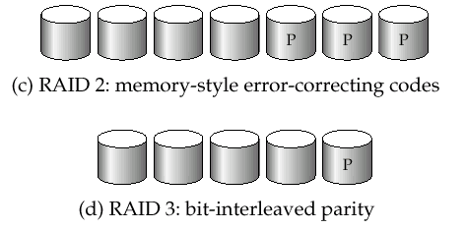
RAID Levels 2 and 3
RAID Level 2: Memory-Style Error-Correcting-Codes (ECC) with bit striping.
RAID Level 3: Bit-Interleaved Parity
a single parity bit is enough for error correction, not just detection, since we know which disk has failed
When writing data, corresponding parity bits must also be computed and written to a parity bit disk
To recover data in a damaged disk, compute XOR of bits from other disks (including parity bit disk)
RAID levels 4-6 elaborate on this idea of parity

Slide 15
Choice of RAID Level
Mirroring provides much better write performance than Parity
For Parity read operations are needed before a write, whereas Mirroring only requires 2 writes
Mirroring preferred for high update environments such as log disks
Mirroring needs more disks for the same capacity
Higher cost per capacity unit
But price of storage capacity is already low and decreasing
Nowadays, for database systems
(Distributed) Parity, with RAID Level 5, is preferred for applications with low update rate, and large amounts of data
Mirroring is preferred for all other applications
The choice of the storage structure is an important first step when designing a real database!

Slide 16

RAID - Redundant Array of Independent Disks
RAID Controller
Host
RAID Array
Notes:
RAID (Redundant Arrays of Independent Disks) combines two or more disk drives in an array into a RAID set or a RAID group. The RAID set appears to the host as a single disk drive. Properly implemented RAID sets provide:
Higher data availability
Improved I/O performance
Streamlined management of storage devices
Historical Note: In 1987, Patterson, Gibson and Katz at the University of California Berkeley, published a paper entitled, "A Case for Redundant Arrays of Inexpensive Disks (RAID)." This paper described various types of disk arrays, referred to by the acronym RAID. At the time, data was stored largely on large, expensive disk drives (called SLED, or Single Large Expensive Disk). The term inexpensive was used in contrast to the SLED implementation. The term RAID has been redefined to refer to independent disks, to reflect the advances in the storage technology.
RAID storage has now grown from an academic concept to an industry standard.

Slide 17
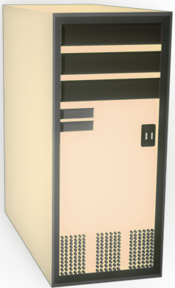

RAID Array Components
Physical Array
Logical Array
RAID Controller
Hard Disks
Host
RAID Array

Slide 18
RAID Implementations
Hardware (usually a specialized disk controller card)
Controls all drives attached to it
Array(s) appear to host operating system as a regular disk drive
Provided with administrative software
Software
Runs as part of the operating system
Performance is dependent on CPU workload
Does not support all RAID levels

Slide 19
RAID Levels
0 Striped array with no fault tolerance
1 Disk mirroring
3 Parallel access array with dedicated parity disk
4 Striped array with independent disks and a dedicated parity disk
5 Striped array with independent disks and distributed parity
6 Striped array with independent disks and dual distributed parity
Nested RAID (i.e., 1 + 0, 0 + 1, etc.)

Slide 20
RAID Redundancy: Parity
0
4
8
1
5
9
RAID Controller
2
6
10
3
Host
7
11
0 1 2 3
4 5 6 7
8 9 10 11
Parity Disk
Notes:
Parity is a redundancy check that ensures that the data is protected without using a full set of duplicate drives.
If a single disk in the array fails, the other disks have enough redundant data so that the data from the failed disk can be recovered.
Like striping, parity is generally a function of the RAID controller and is transparent to the host.
Parity information can either be:
Stored on a separate, dedicated drive (RAID-3)
Distributed with the data across all the drives in the array (RAID-5)

Slide 21
Parity Calculation
5 + 3 + 4 + 2 = 14
5
Data
3
Data
The middle drive fails:
Data
4
5 + 3 + ? + 2 = 14
? = 14 – 5 – 3 – 2
? = 4
2
Data
14
Parity
RAID Array
Notes:
This example uses arithmetic operations to demonstrate how parity works. It illustrates the concept, but not the actual mechanism.
Think of parity as the sum of the data on the other disks in the RAID set. Each time data is updated, the parity is updated as well, so that it always reflects the current sum of the data on the other disks.
Note: While parity is calculated on a per stripe basis, the diagram omits this detail for the sake of simplification.
If a disk fails, the value of its data is calculated by using the parity information and the data on the surviving disks.
If the parity disk fails, the value of its data is calculated by using the data disks. Parity will only need to be recalculated, and saved, when the failed disk is replaced with a new disk.
In the event of a disk failure, each request for data from the failed disk requires that the data be recalculated before it can be sent to the host. This recalculation is time-consuming, and decreases the performance of the RAID set. Hot spare drives, introduced later, provide a way to minimize the disruption caused by a disk failure.
The actual parity algorithm use the Boolean exclusive-OR (XOR) operations.

Slide 22
Lecture 8, 9, 10
Different RAID levels and their suitability for different application environments: RAID 0, RAID 1

Slide 23

RAID 0 – Striped Array with no Fault Tolerance
0
1
5
9
RAID Controller
2
6
10
3
Host
7
11

Slide 24
RAID 1 – Disk Mirroring
Block 0
RAID Controller
Block 1
Block 1
Block 1
Block 0
Block 0
Host

Slide 25
Nested RAID – 0+1 (Striping and Mirroring)
RAID 1
Block 0
Block 2
Block 0
RAID Controller
RAID 0
Block 3
Block 2
Block 1
Block 1
Host
Block 3

Slide 26
Nested RAID – 0+1 (Striping and Mirroring)
RAID 1
Block 0
Block 0
Block 0
Block 2
Block 2
Block 2
RAID Controller
RAID 0
Block 1
Block 1
Block 1
Block 3
Block 3
Host
Block 3

Slide 27
Nested RAID – 1+0 (Mirroring and Striping)
RAID 0
Block 1
Block 3
Block 2
RAID Controller
RAID 1
Block 2
Block 0
Block 0
Block 1
Host
Block 3

Slide 28
Nested RAID – 1+0 (Mirroring and Striping)
RAID 0
Block 0
Block 1
Block 2
Block 3
RAID Controller
RAID 1
Block 0
Block 0
Block 1
Block 2
Host
Block 2
Block 3

Slide 29
RAID 0+1 vs. RAID 1+0
Benefits are identical under normal operations
Rebuild operations are very different
RAID 1+0 uses a mirrored pair – only 1 disk is rebuilt if a disk fails
RAID 0+1 if a single drive fails, the entire stripe is faulted
RAID is 0+1 is a poorer solution and is less common
Notes:
Do not confuse RAID 1+0 with RAID 0+1. The benefits offered by theses combinations of RAID level are identical while all the disks are operating normally. If a failure occurs, however, the rebuild operations are very different.
RAID 1+0 has a mirrored pair as its basic element. If a drive fails and is replaced, only the mirror needs to be rebuilt. In other words, the disk array controller uses the surviving drive in the mirrored pair for data recovery and continuous operation. Data from one surviving disk will be copied to the replacement disk.
Note: If there is a hot spare, data is rebuilt onto the hot spare from the surviving drive in the mirrored pair . When the failed disk is replaced, data from the surviving drive in the mirrored pair is used to rebuild the data on the replaced disk.
RAID 0+1 uses a stripe as its basic element. The stripe has no protection (RAID 0). If a single drive fails, the entire stripe is faulted, meaning that only half the disks in the RAID set are available for data access. A rebuild operation rebuilds the entire stripe, copying data from each disk in the healthy stripe to the equivalent disk in the failed stripe. This causes increased, and unneeded, I/O load on the backend, and also makes the RAID set more vulnerable to a second disk failure.
RAID 0+1 is less common than RAID 1+0, and is a poorer solution.

Slide 30
RAID Redundancy: Parity
0
4
8
1
5
9
RAID Controller
2
6
10
3
Host
7
11
0 1 2 3
4 5 6 7
8 9 10 11
Parity Disk
Notes:
Parity is a redundancy check that ensures that the data is protected without using a full set of duplicate drives.
If a single disk in the array fails, the other disks have enough redundant data so that the data from the failed disk can be recovered.
Like striping, parity is generally a function of the RAID controller and is transparent to the host.
Parity information can either be:
Stored on a separate, dedicated drive (RAID-3)
Distributed with the data across all the drives in the array (RAID-5)

Slide 31
RAID Redundancy: Parity
0
4
1
6
5
9
RAID Controller
1
?
3
7
Host
7
11
The middle drive fails:
Parity calculation 4 + 6 + 1 + 7 = 18
0 1 2 3
4 5 6 7
4 + 6 + ? + 7 = 18
? = 18 – 4 – 6 – 7
? = 1
18
Parity Disk

Slide 32
RAID 3 – Parallel Transfer with Dedicated Parity Disk
Block 3
RAID Controller
Block 2
Block 1
Block 0
Block 0
Block 1
Parity Generated
Block 2
Host
Block 3
P 0 1 2 3

Slide 33
RAID 4 – Striping with Dedicated Parity Disk
Block 0
Block 0
Block 4
Block 1
Block 5
Parity Generated
Block 2
Block 0
RAID Controller
Block 0
Block 6
P 0 1 2 3
Block 3
Host
Block 7
P 0 1 2 3
P 0 1 2 3
P 4 5 6 7
Notes:
RAID Level 4 stripes data for high performance and uses parity for improved fault tolerance. Data is striped across all the disks, but one in the array. Parity information is stored on a dedicated disk so that data can be reconstructed if a drive fails.
The data disks are independently accessible, and multiple reads and writes can occur simultaneously.
Benefits - the total number of disks is less than in a mirrored solution (e.g., 1.25 times the data disks for group of 5), good read throughput, and reasonable write throughput.
Drawbacks – the dedicated parity drive can be a bottleneck when handling small data writes. This RAID level is not well suited to transaction processing applications. Data loss if multiple drives fail within the same RAID 4 Group.
Performance - high data read transfer rate. Poor to medium write transfer rate. Disk failure has a significant impact on throughput
Data Protection - uses parity for improved fault tolerance.
Striping – usually at the block (or block multiple) level
Applications – general purpose file storage
RAID 4 is much less commonly used than RAID 5, discussed next. The dedicated parity drive is a bottleneck, especially when a disk failure has occurred.

Slide 34
RAID 5 – Independent Disks with Distributed Parity
Block 0
Block 0
Block 4
Block 4
Block 1
Block 5
Parity Generated
Block 2
Parity Generated
Block 4
RAID Controller
Block 0
Block 0
Block 4
Block 6
P 0 1 2 3
P 4 5 6 7
Block 3
Host
P 4 5 6 7
P 4 5 6 7
P 0 1 2 3
P 0 1 2 3
Block 7

Slide 35
Buffer-Replacement Policies (Cont.)
Pinned block – memory block that is not allowed to be written back to disk.
Toss-immediate strategy – frees the space occupied by a block as soon as the final tuple of that block has been processed
Most recently used (MRU) strategy – system must pin the block currently being processed. After the final tuple of that block has been processed, the block is unpinned, and it becomes the most recently used block.
Buffer managers also support forced output of blocks for the purpose of recover
To implement such specific policies a (good) database management system must usually implement its own buffer replacement policy (not relying in that of the operating system!)

Slide 36
File Organization
The database is stored as a collection of files. Each file is a sequence of records. A record is a sequence of fields.
First approach:
assume record size is fixed
each file has records of one particular type only
different files are used for different relations
This case is the easiest to implement.

Slide 37
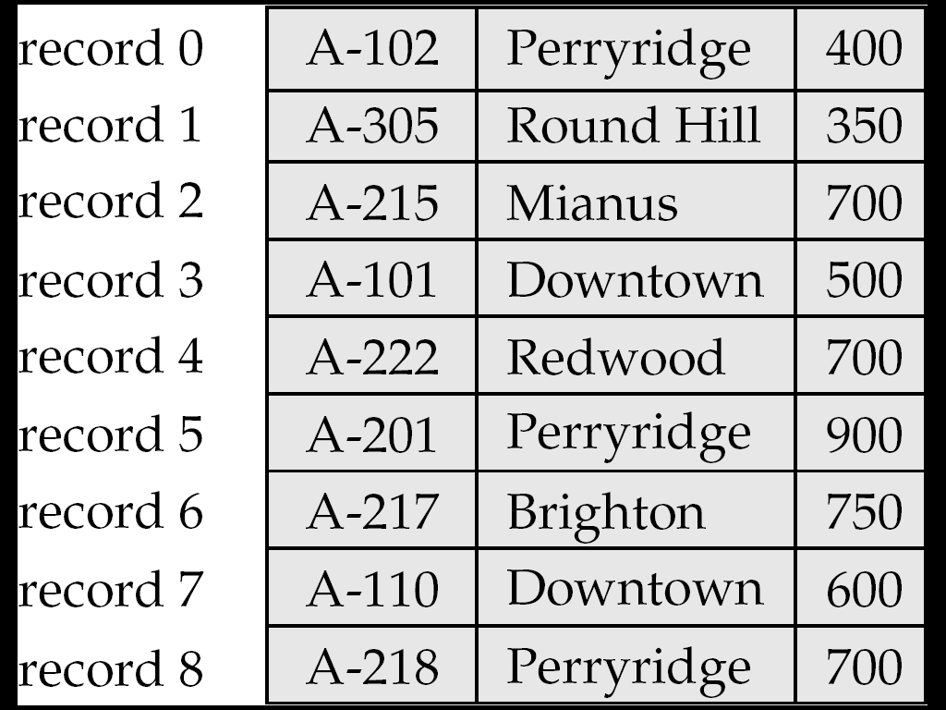
Fixed-Length Records
Simple approach:
Store record i starting from byte n ∗ (i – 1), where n is the size of each record.
Record access is simple but records may cross blocks!
Modification: do not allow records to cross block boundaries
Deletion of record i: alternatives:
move records i + 1, . . ., n to i, . . . , n – 1
move record n to i
do not move records, but link all free records on a free list

Slide 38
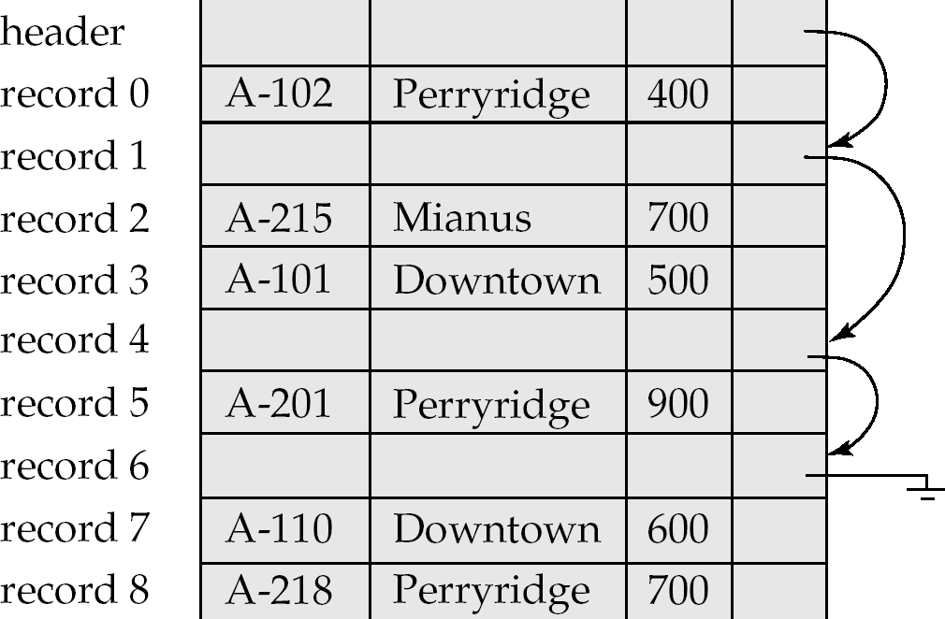
Free Lists
Store the address of the first deleted record in the file header.
Use this first record to store the address of the second deleted record, and so on
Can think of these stored addresses as pointers since they “point” to the location of a record.
More space efficient representation: reuse space for normal attributes of free records to store pointers. (No pointers stored in in-use records.)

Slide 39
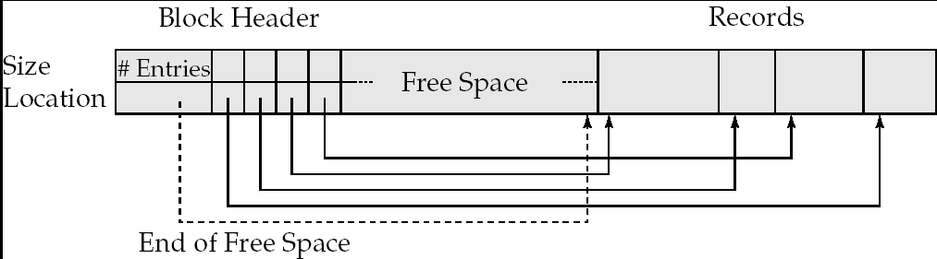
Variable-Length Records: Slotted Page Structure
Slotted page are usually the size of a block
Header contains:
number of record entries
end of free space in the block
location and size of each record
Records can be moved around within a page to keep them contiguous with no empty space between them; entry in the header must be updated.
(Other) pointers should not point directly to record — instead they should point to the entry for the record in header.

Slide 40
Variable-Length Records
Variable-length records arise in database systems in several ways:
Storage of multiple record types in a file.
Record types that allow variable lengths for one or more fields.
If slotted pages are the size of a block, the issue of records spanning over more than one block is eliminated
This limits the size of records in a database, which is usually the (default) case
There are special types for big records, that are treated differently (remember the clobs and blobs in Oracle?)

Slide 41
Organization of Records in Files
Heap – a record can be placed anywhere in the file where there is space
Sequential – store records in sequential order, based on the value of the search key of each record
Hashing – a hash function computed on some attribute of each record; the result specifies in which block of the file the record should be placed
Records of each relation may be stored in a separate file. In a multitable clustering file organization records of several different relations can be stored in the same file
Motivation: store related records on the same block to minimize I/O
The choice of a proper organization of records in a file is important for the efficiency of real databases!

Slide 42
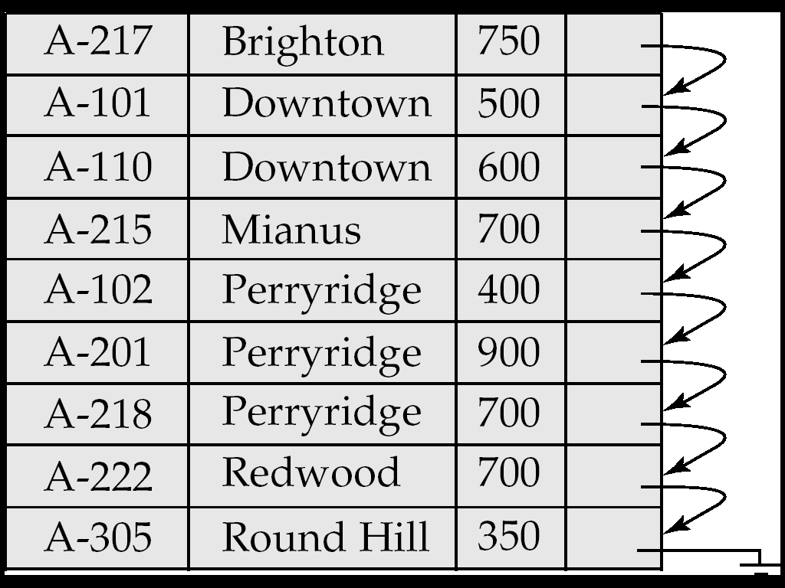
Sequential File Organization
Suitable for applications that require sequential processing of the entire file
The records in the file are ordered by a search-key

Slide 43
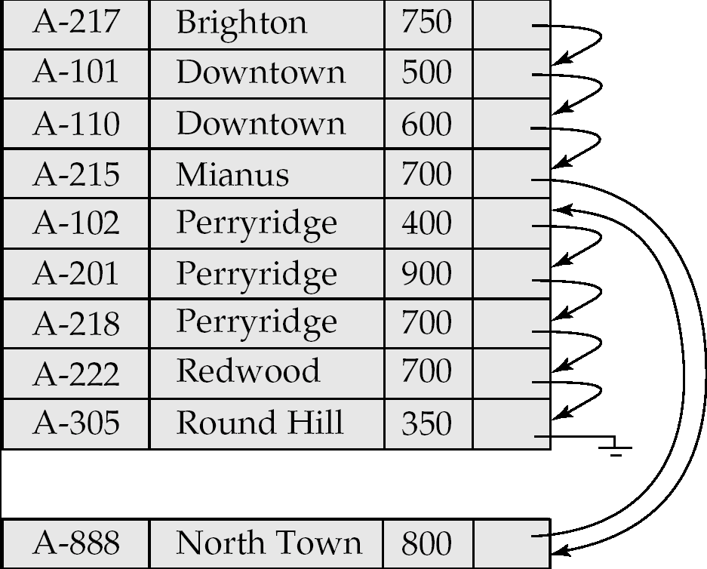
Sequential File Organization (Cont.)
Deletion – use pointer chains
Insertion –locate the position where the record is to be inserted
if there is free space insert there
if no free space, insert the record in an overflow block
In either case, pointer chain must be updated
Need to reorganize the file from time to time to restore sequential order

Slide 44
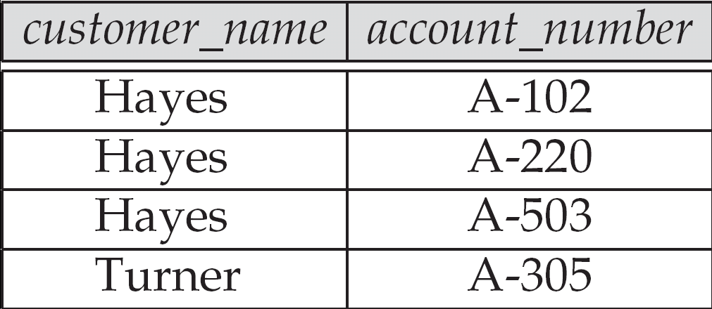
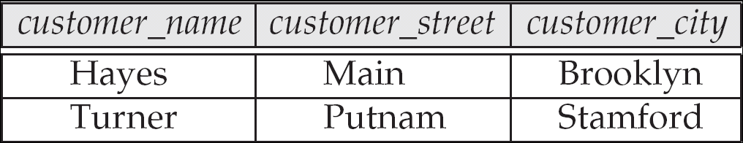
Multitable Clustering File Organization
Store several relations in one file using a multitable clustering file organization.

Slide 45
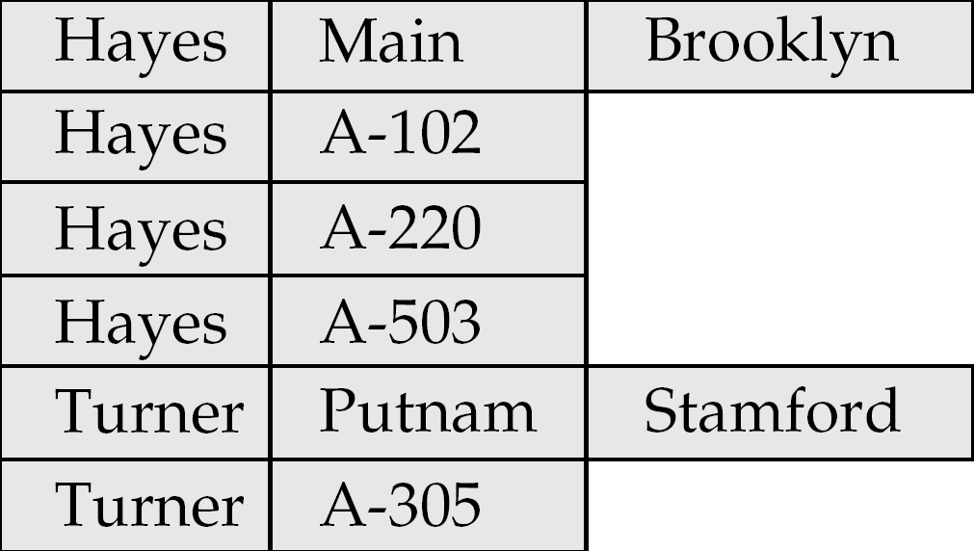
Multitable Clustering File Organization (cont.)
Multitable clustering organization of customer and depositor:
good for queries involving depositor customer, and for queries involving one single customer and his accounts
bad for queries involving only customer
but one can add pointer chains to link records of a particular relation
results in variable size records

Slide 46
File System
In sequential file organization, each relation is stored in a file
One may rely in the file system of the underlying operating system
Multitable clustering may have significant gains in efficiency
But this may not be compatible with the file system of the operating system
Several large scale database management systems do not rely directly on the underlying operating system
The relations are all stored in a single (multitable) file
The database management system manages the file by itself
This requires the implementation of an own file system inside the DBMS

Slide 47
Data Dictionary Storage
Data dictionary (also called system catalog) stores metadata; that is, data about data, such as
Information about relations
names of relations
names and types of attributes of each relation
names and definitions of views
integrity constraints
User and accounting information, including passwords
Statistical and descriptive data
number of tuples in each relation
Physical file organization information
How relation is stored (sequential/hash/…)
Physical location of relation
Information about indices (next lecture)

Slide 48
Data Dictionary Storage (Cont.)
Catalog structure
Relational representation on disk
specialized data structures designed for efficient access, in memory
A possible catalog representation:
Relation_metadata = (relation_name, number_of_attributes, storage_organization, location) Attribute_metadata = (attribute_name, relation_name, domain_type, position, length)
User_metadata = (user_name, encrypted_password, group)
Index_metadata = (index_name, relation_name, index_type, index_attributes)
View_metadata = (view_name, definition)

Slide 49
File Organization in Oracle
Oracle has its own buffer management, with complex policies
Oracle doesn’t rely on the underlying operating system’s file system
A database in Oracle consists of tablespaces:
System tablespace: contains catalog meta-data
User data tablespaces
The space in a tablespace is divided into segments:
Data segment
Index segment
Temporary segment (for sort operations)
Rollback segment (for processing transactions)
Segments are divided into extents, each extent being a set of contiguous database blocks.
A database block need not be the same size of an operating system block, but is always a multiple

Slide 50
File Organization in Oracle (cont.)
A standard table is organized in a heap (no sequence is imposed)
Partitioning of tables is possible for optimization
Range partitioning (e.g by dates)
Hash partitioning
Composite partitioning
Table data in Oracle can also be (multitable) clustered
One may tune the clusters to significantly improve the efficiency of query to frequently used joins.
Hash file organization (to be studied in the sequel) is also possible for fetching the appropriate cluster
A database can be tuned by an appropriate choice for the organization of data:
Choosing partitions
Appropriate choice of clusters
Hash or sequential
Tuning makes the difference in big (real) databases!

